Slide 2
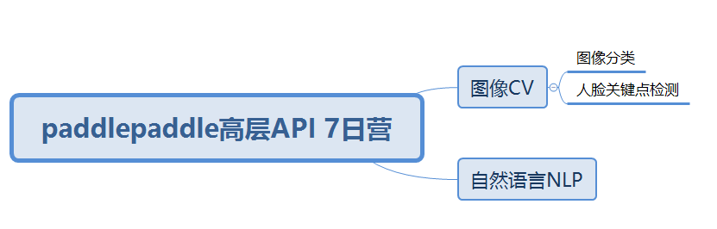
Notes:
Note:
You can add abstract backgrounds here

Slide 3
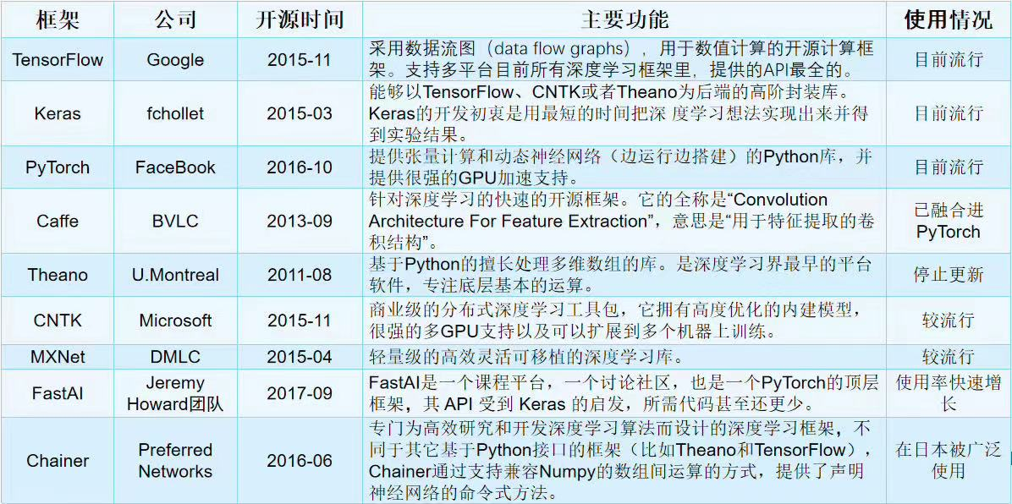

Slide 4
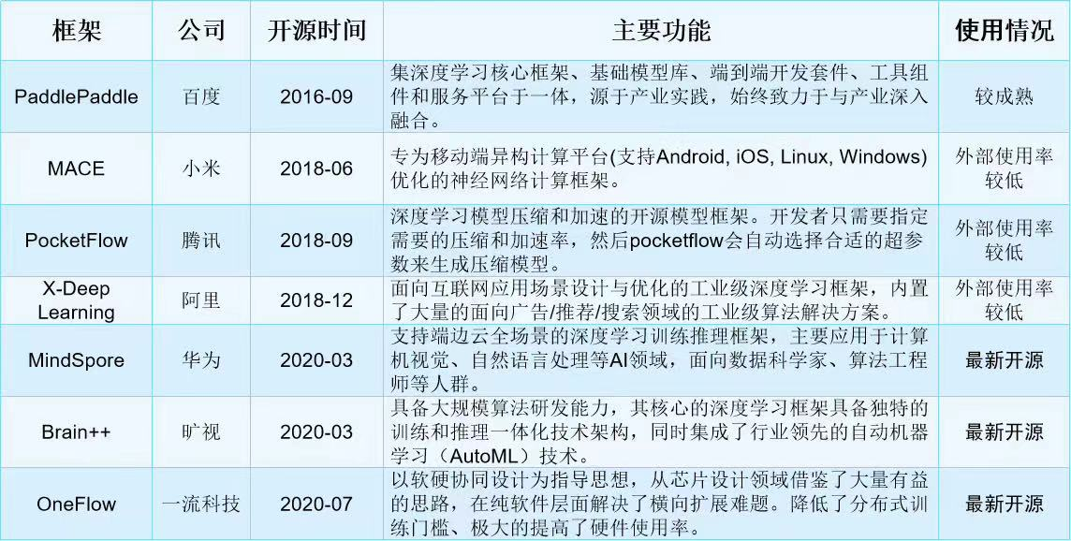

Slide 5
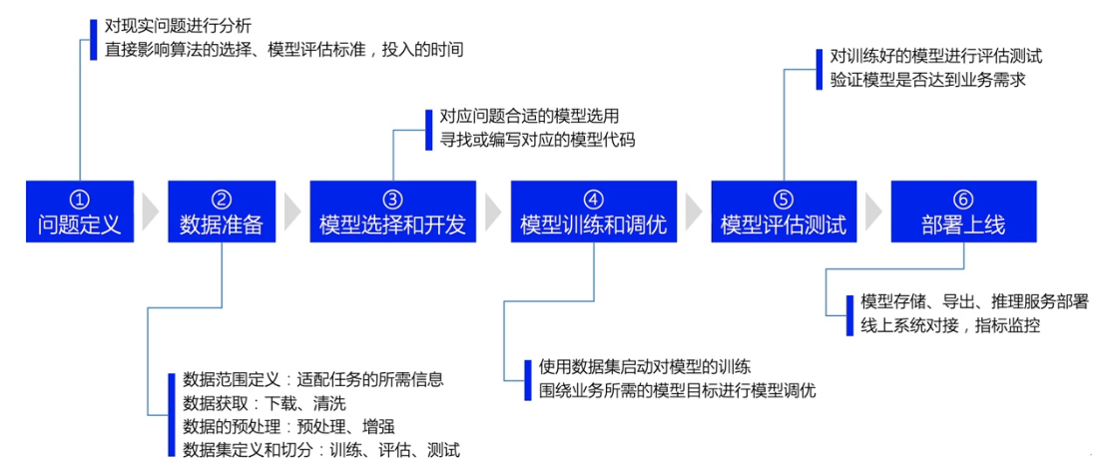
Paddle全套AI开发：https://www.paddlepaddle.org.cn/overview

Slide 6
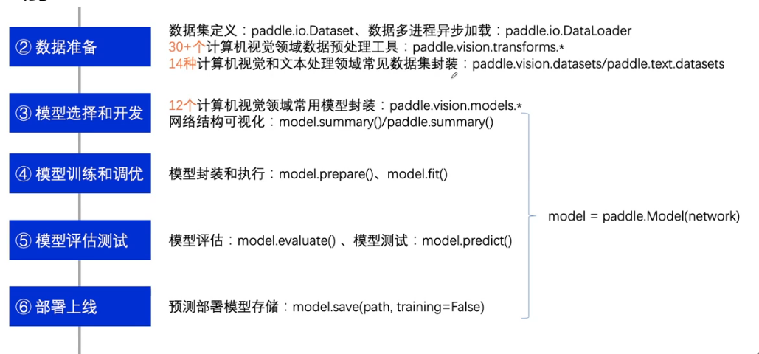

Slide 7
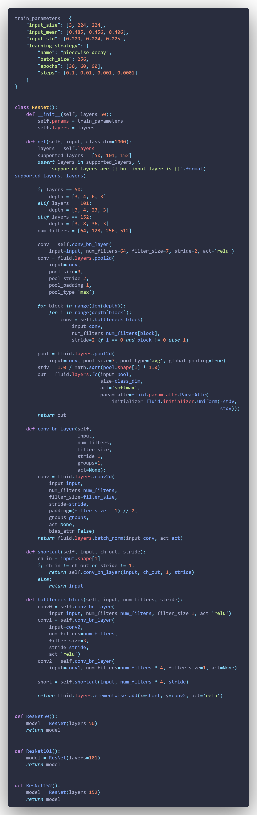
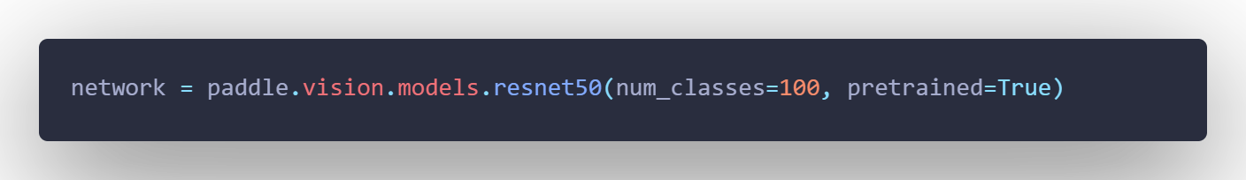
Notes:
Note:
You can change the gradient of each component
Author: Elvis Saravia

Slide 8
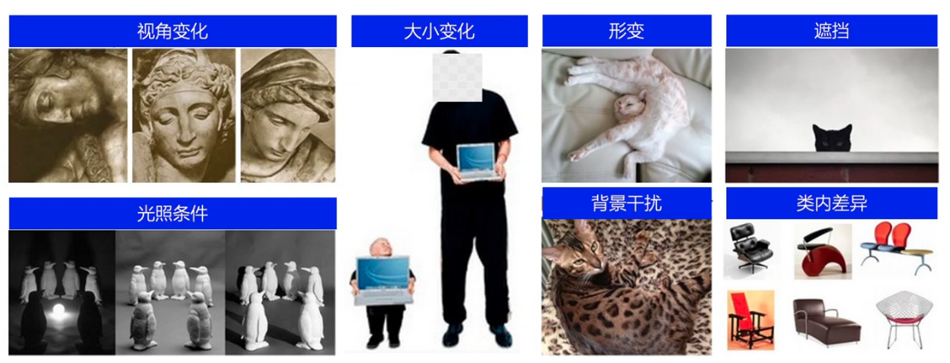

Slide 9
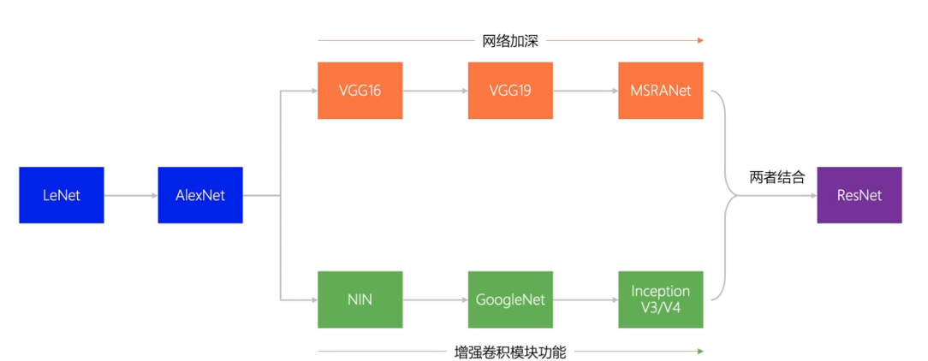

Slide 10
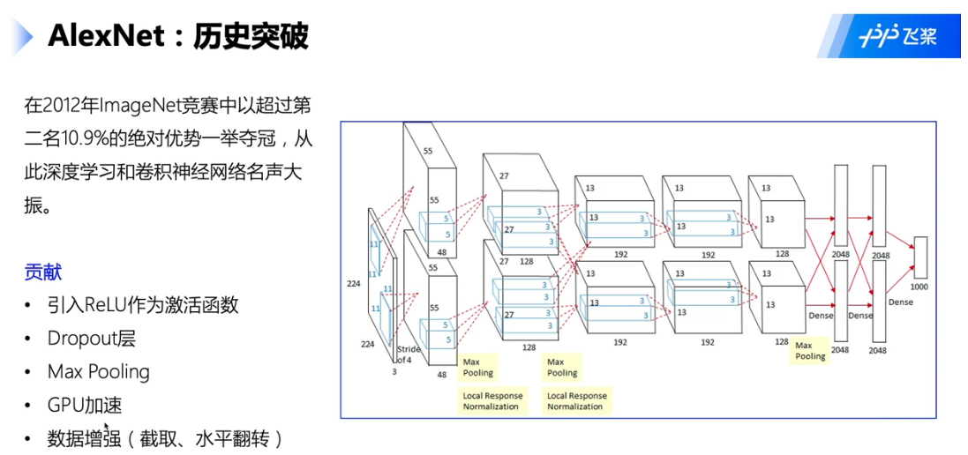

Slide 11
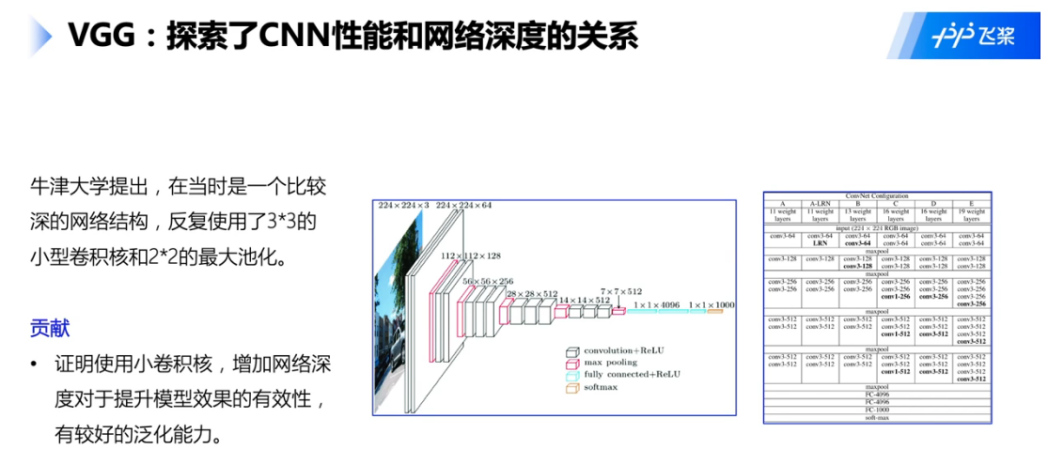

Slide 12
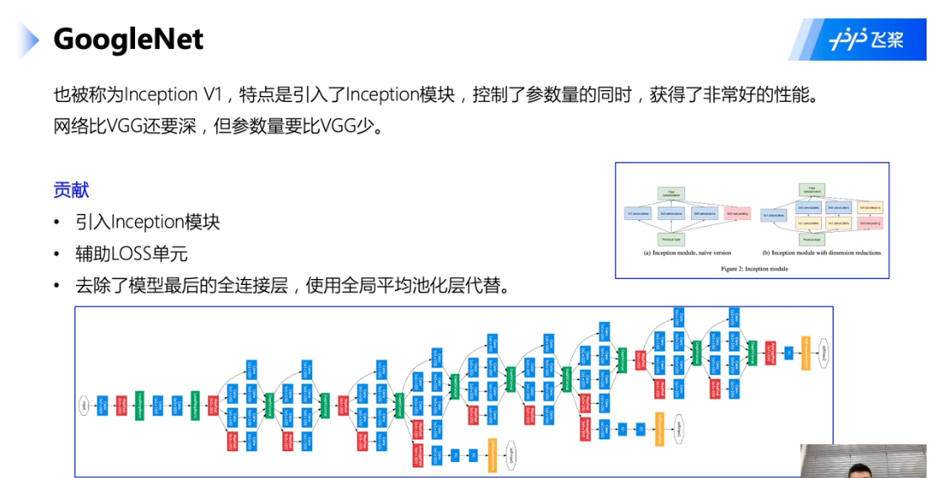

Slide 13
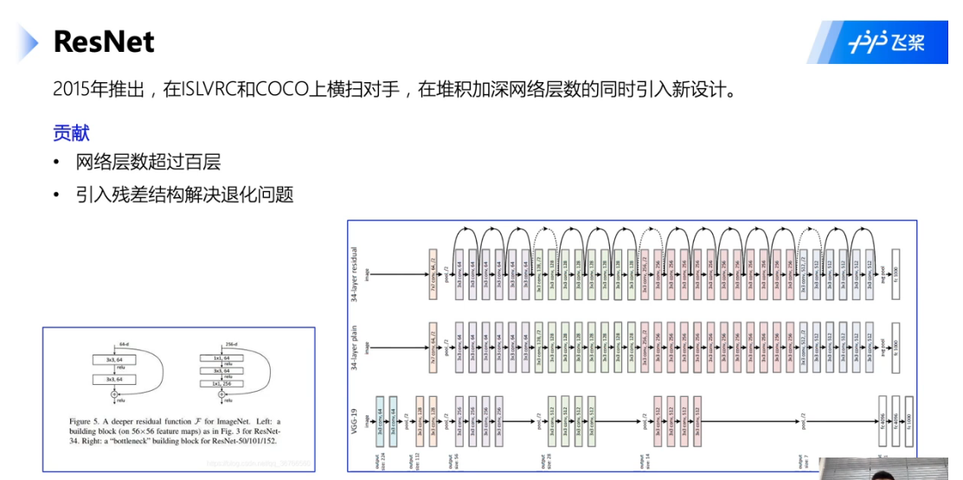

Slide 14
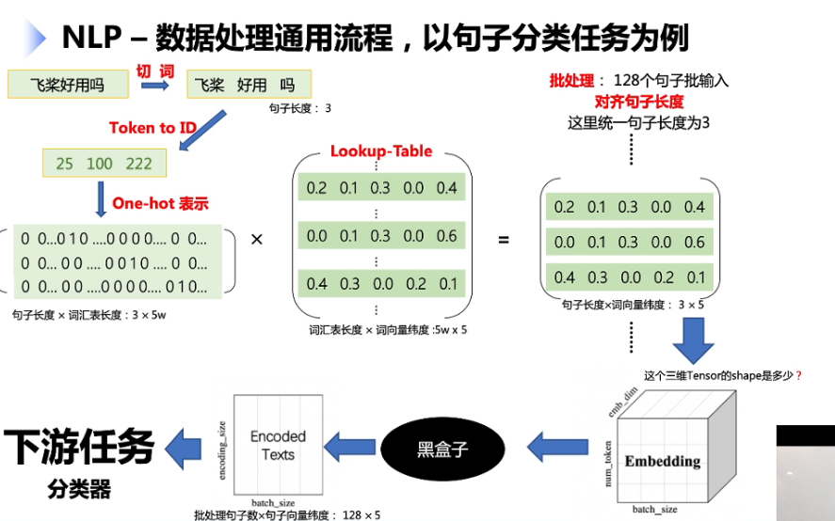

Slide 15
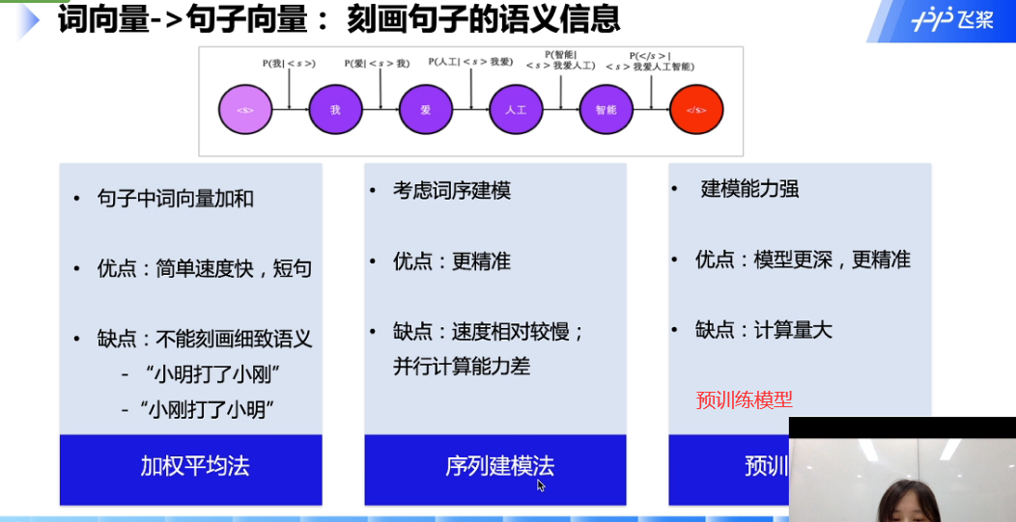

Slide 16
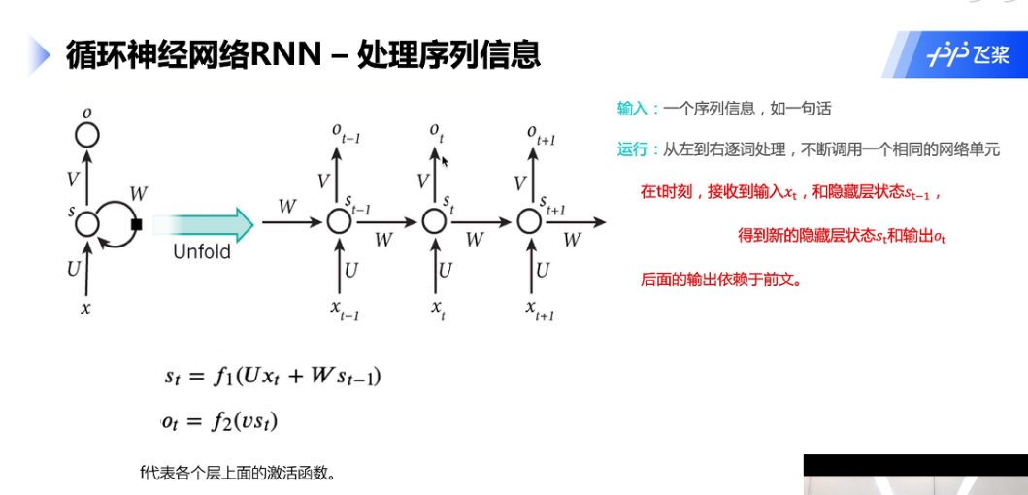

Slide 17
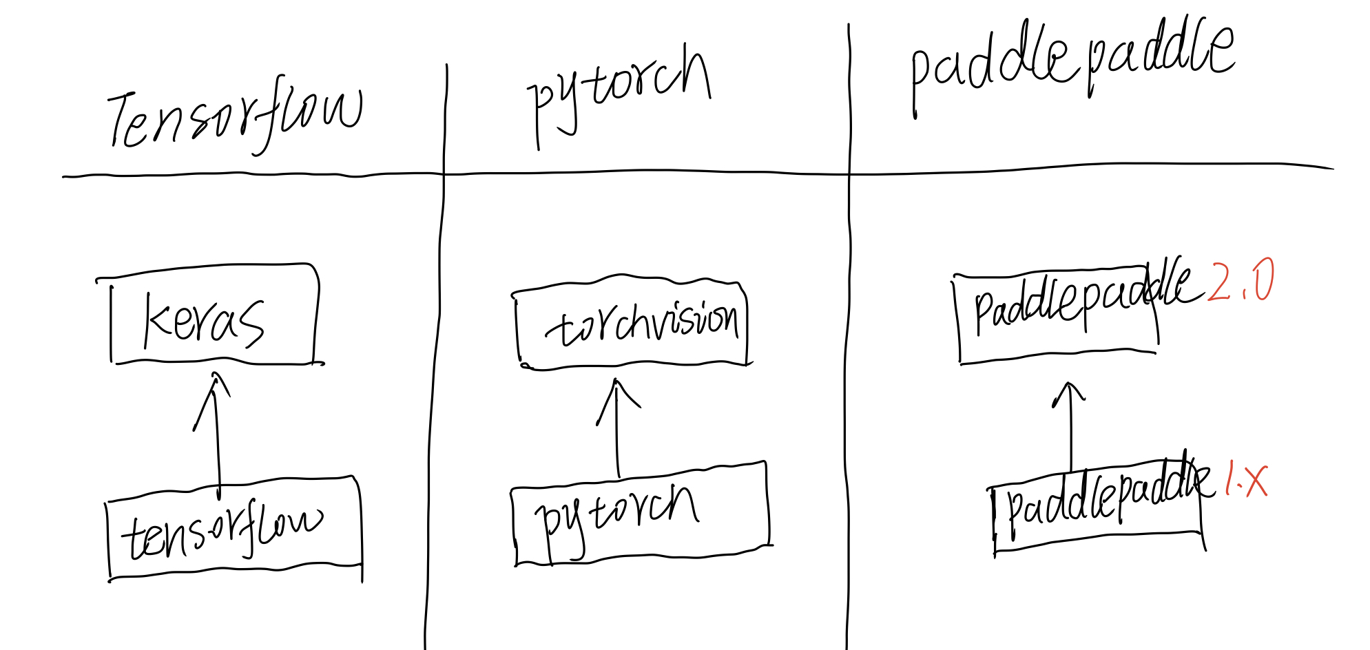
Notes:
Note:
These visuals could represent transformations (left) or operations (right)
The visuals on the right use the Math Equations Add on for Google Slides.
If you click on the equation you are able to modify it by:
Selecting Add Ons → Math Equations → Menu
While the equation is selected, click “Connect to Equation” on the “Math Equations UI”
Then change the properties like color, size, etc.
Author: Elvis Saravia (ellfae@gmail.com)
Log:
Added a dark theme version of the previous slide

Slide 18
Basic components
Notes:
Note:
Basic components go here.

Slide 19
Notes:
Note:
This is a simple round rectangle that can represent some process, operation, or transformation
Author: Elvis Saravia (ellfae@gmail.com)

Slide 20
Notes:
Symbolizing an embedding

Slide 21
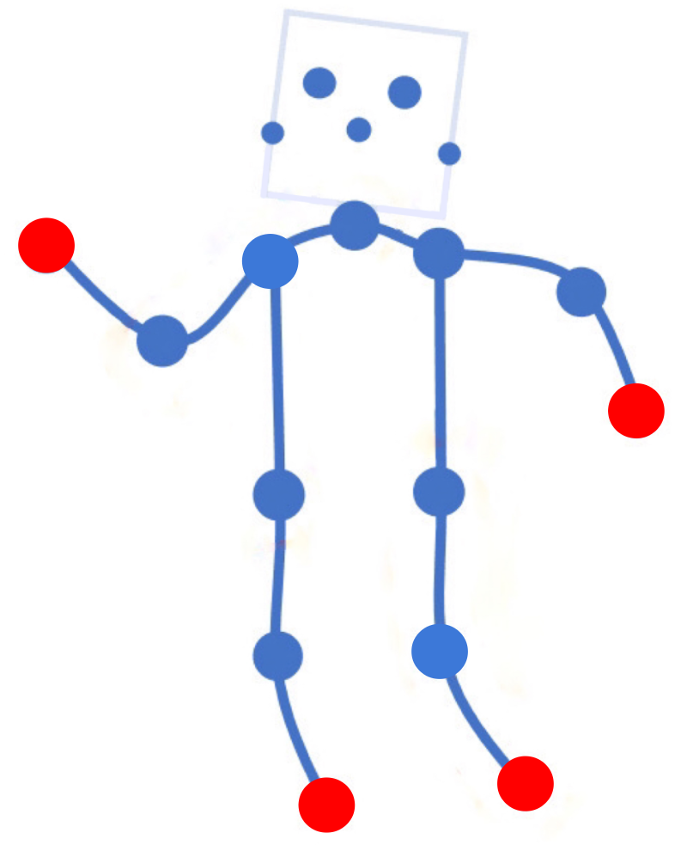
Time
Unbearable
Pain
Level 5
Level 4
High
Pain
MediumPain
Level 3
Level 2
LowPain
Level 1
No Pain
(a)
(b)

Slide 22
Notes:
Note:
Can represent a neuron or some arbitrary operation
Author: Elvis Saravia (ellfae@gmail.com)

Slide 23




Softmax
Convolve
Sharpen
Notes:
Note:
These visuals could represent transformations (left) or operations (right)
The visuals on the right use the Math Equations Add on for Google Slides.
If you click on the equation you are able to modify it by:
Selecting Add Ons → Math Equations → Menu
While the equation is selected, click “Connect to Equation” on the “Math Equations UI”
Then change the properties like color, size, etc.
Author: Elvis Saravia (ellfae@gmail.com)

Slide 24




Softmax
Convolve
Sharpen
Notes:
Note:
These visuals could represent transformations (left) or operations (right)
The visuals on the right use the Math Equations Add on for Google Slides.
If you click on the equation you are able to modify it by:
Selecting Add Ons → Math Equations → Menu
While the equation is selected, click “Connect to Equation” on the “Math Equations UI”
Then change the properties like color, size, etc.
Author: Elvis Saravia (ellfae@gmail.com)
Log:
Added a dark theme version of the previous slide

Slide 25
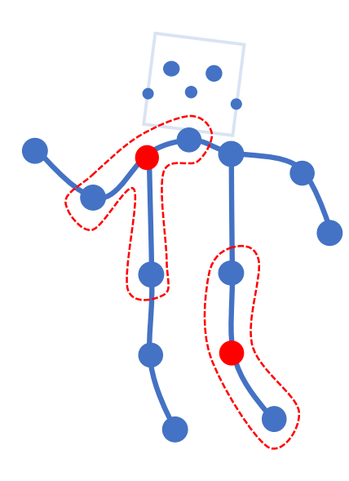
Notes:
Note:
Can represent a multidimensional array (2D)
Author: Elvis Saravia (ellfae@gmail.com)

Slide 26
Notes:
Note:
This can be used to represent a vector. If you want to edit the distance between each element, you can “ungroup” the shapes and then modify the distance between the individual lines.
Author: Elvis Saravia (ellfae@gmail.com)

Slide 27
Notes:
Note:
These visuals can represent a multi-directional array (3D)
Author: Elvis Saravia (ellfae@gmail.com)

Slide 28
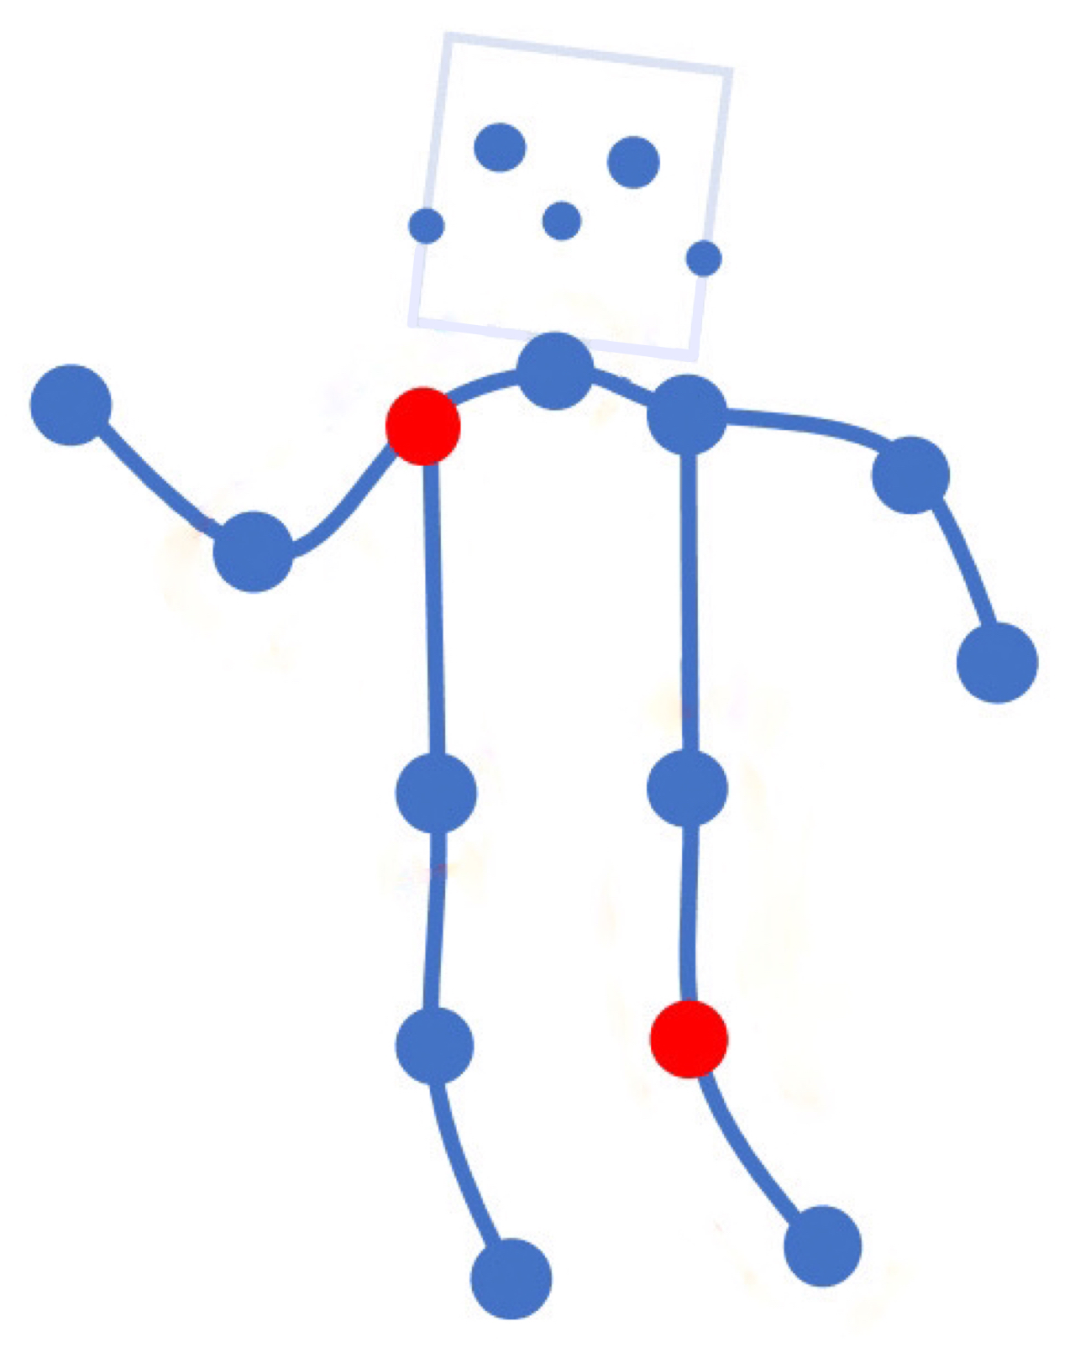
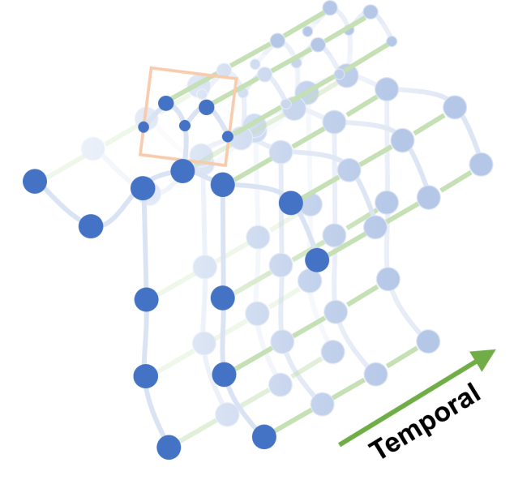
Notes:
Note:
Can represent a multidimensional array (2D)
Author: Elvis Saravia (ellfae@gmail.com)

Slide 30
APP
疼痛等级
治疗力度
脑电波头盔
疼痛治疗仪
疼痛位置
治疗方案
使用者的治疗时长、治疗方案、治疗反馈记录
Notes:
Note:
Can represent a multidimensional array (2D)
Author: Elvis Saravia (ellfae@gmail.com)

Slide 31
Level 1
Level 2
Level 3
Level 4
No Pain
Low Pain
Moderate Pain
High Pain
Signal Segmentation
Notes:
Note:
Can represent a multidimensional array (2D)
Author: Elvis Saravia (ellfae@gmail.com)

Slide 33
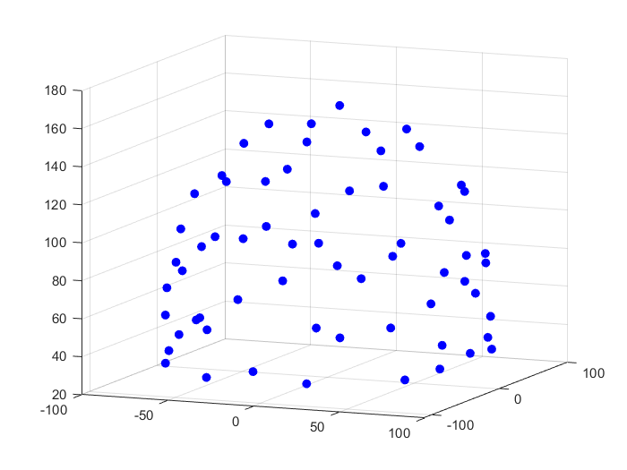
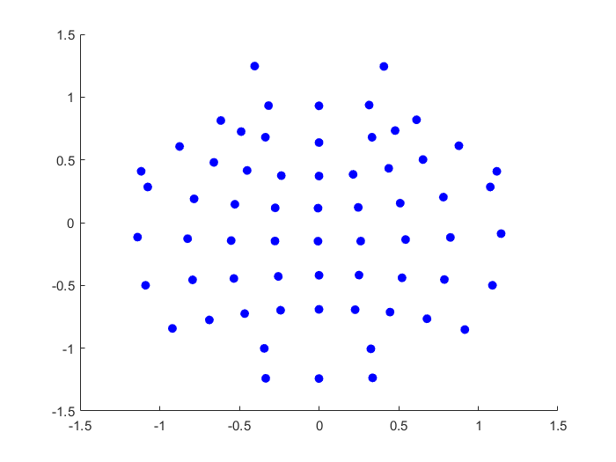
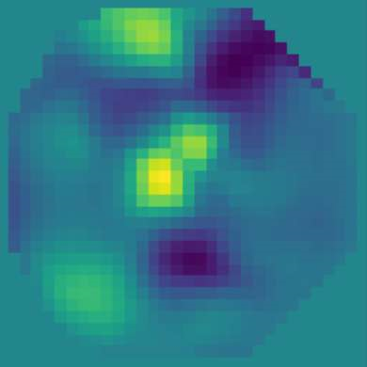
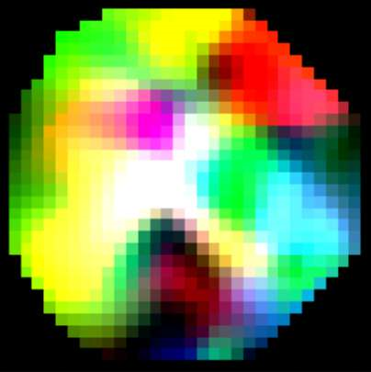
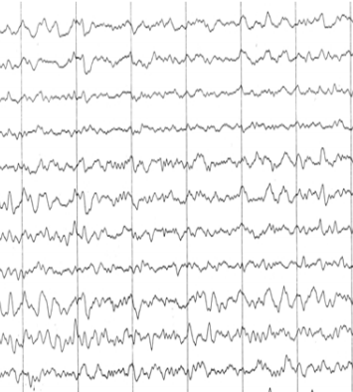
AEP
Bicubic
PSD
Theta(4~8Hz)
Alpha(8~13Hz)
Beta(13~30Hz)
Spectral Topography Map
FFT
Image Generation
Notes:
Note:
This can be used to represent a vector. If you want to edit the distance between each element, you can “ungroup” the shapes and then modify the distance between the individual lines.
Author: Elvis Saravia (ellfae@gmail.com)

Slide 34
Input
Conv3-32
x4
Maxpool
(2x2)
Conv3-64
x2
32x32x3
Maxpool
(2x2)
Conv3-
128
Maxpool
(2x2)
Output
FC-512
Feature
Vector
ConvNet Configuration
Notes:
Note:
These visuals can represent a multi-directional array (3D)
Author: Elvis Saravia (ellfae@gmail.com)

Slide 35
Layer1
Layer2
Layer3
Layer1
Layer2
Layer3
Layer4
Input
Output
Conv3-32
Conv3-32
Conv3-32
Conv3-32
Max-Pool
Conv3-64
Max-Pool
Conv3-128
Max-Pool
Conv3-64
FC-512
Input
Conv
Max-Pool
Conv
Max-Pool
FC
FC
Softmax
ConvNet Configuration
Stack1
Stack2
Stack3
Stack4
Conv3-32
Output
Feature
Vector
Conv3-32
Conv3-32
Conv3-32
Max-Pool
Conv3-64
Max-Pool
Conv3-128
Max-Pool
Conv3-64
FC-512
Notes:
By @avsthiago

Slide 36
Stack1
Stack2
Stack3
Stack4
Conv3-32
Output
Conv3-32
Conv3-32
Conv3-32
Max-Pool
Conv3-64
Max-Pool
Conv3-128
Max-Pool
Conv3-64
FC-512

Slide 37
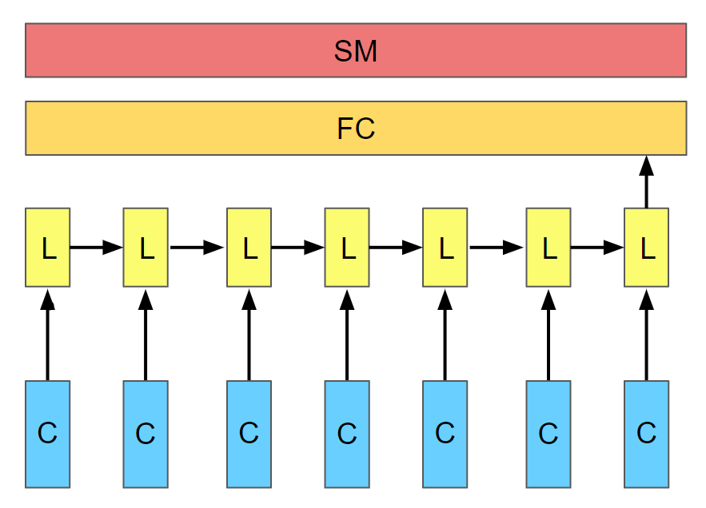
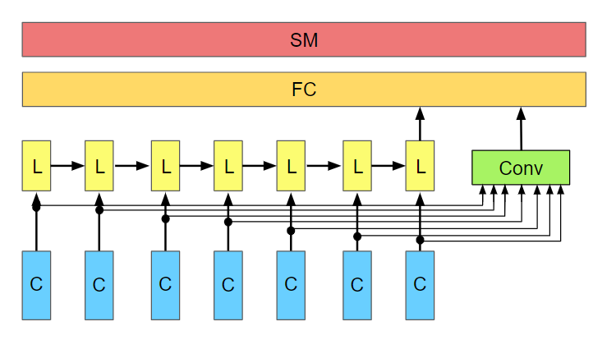
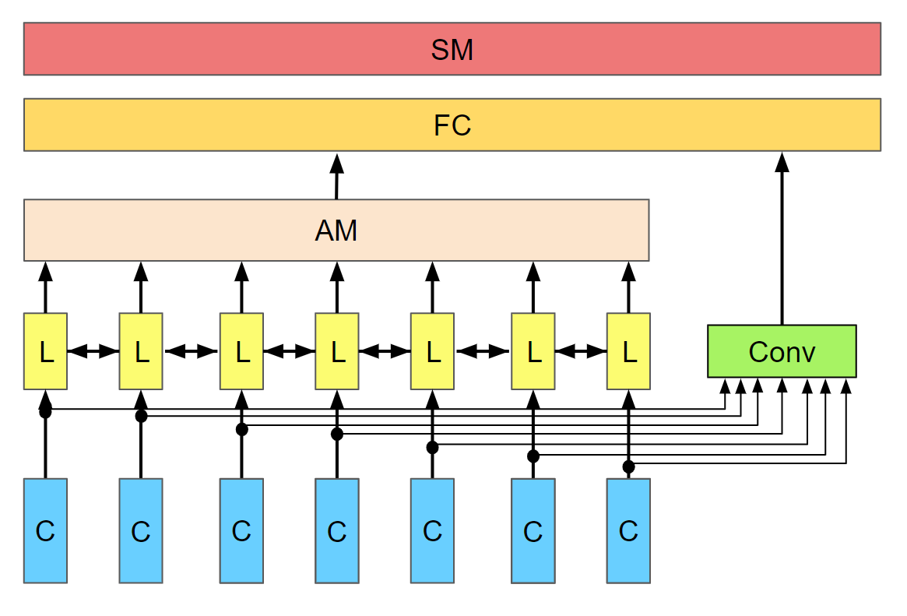
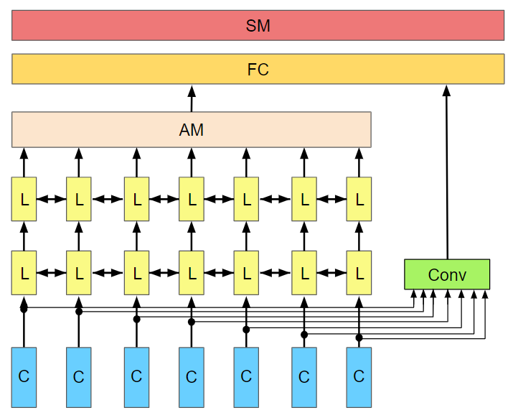

Slide 38
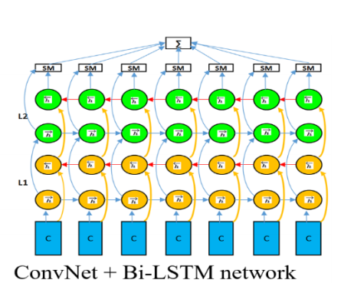
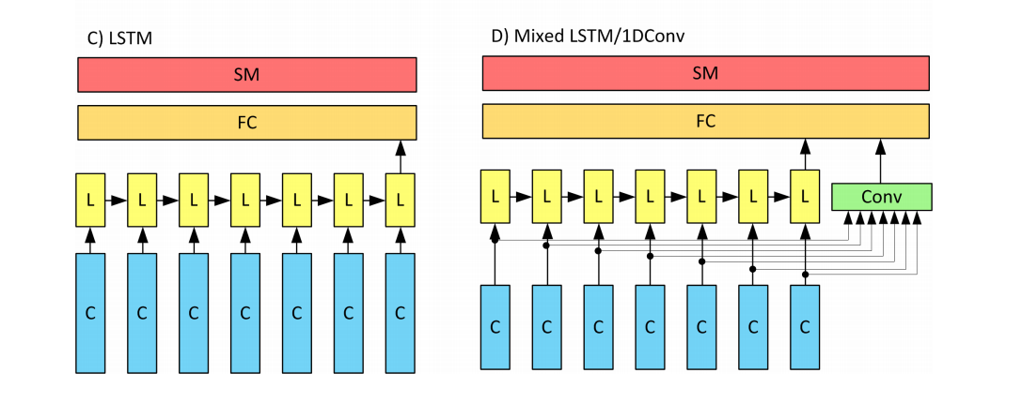
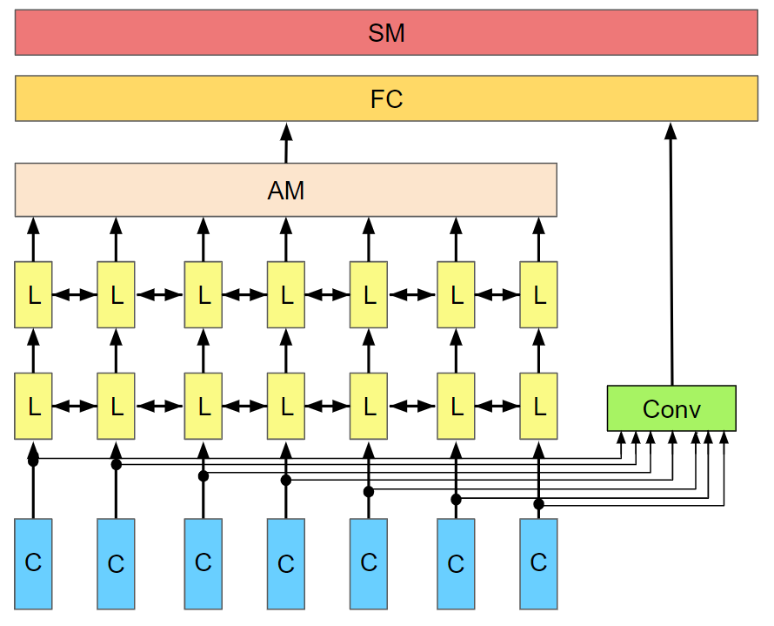
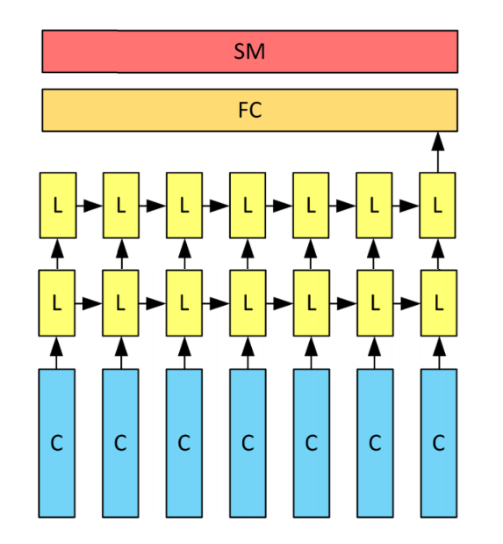
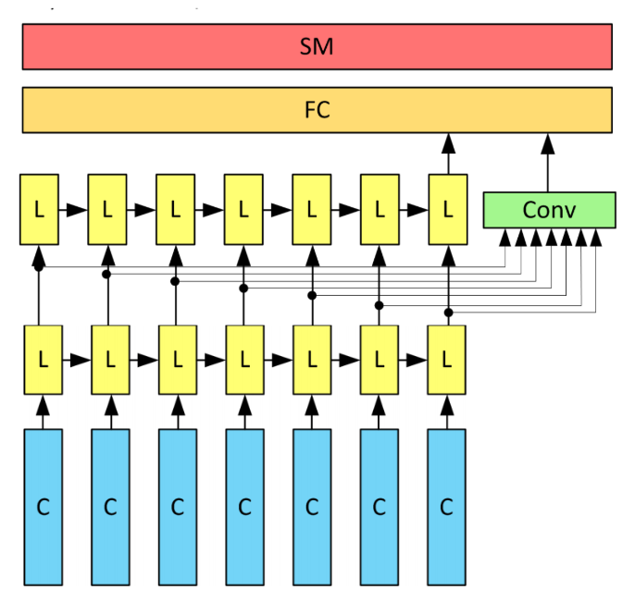
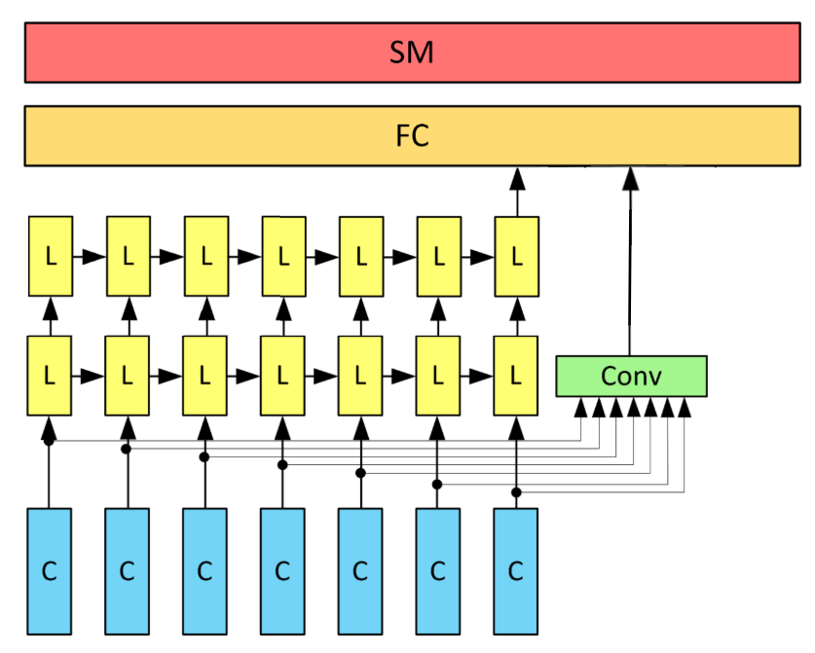
Notes:
Note:
Can represent a multidimensional array (2D)
Author: Elvis Saravia (ellfae@gmail.com)

Slide 39
SM
FC
AM
L
L
L
L
L
L
L
L
L
L
L
L
L
L
Conv
C
C
C
C
C
C
C

Slide 40
SM
FC
L
L
L
L
L
L
L
Conv
C
C
C
C
C
C
C

Slide 41
SM
FC
L
L
L
L
L
L
L
L
L
L
C
C
C
C
C
C
C
C
C
C

Slide 42
SM
FC
Conv
C
C
C
C
C
C
C
C
C
C

Slide 43
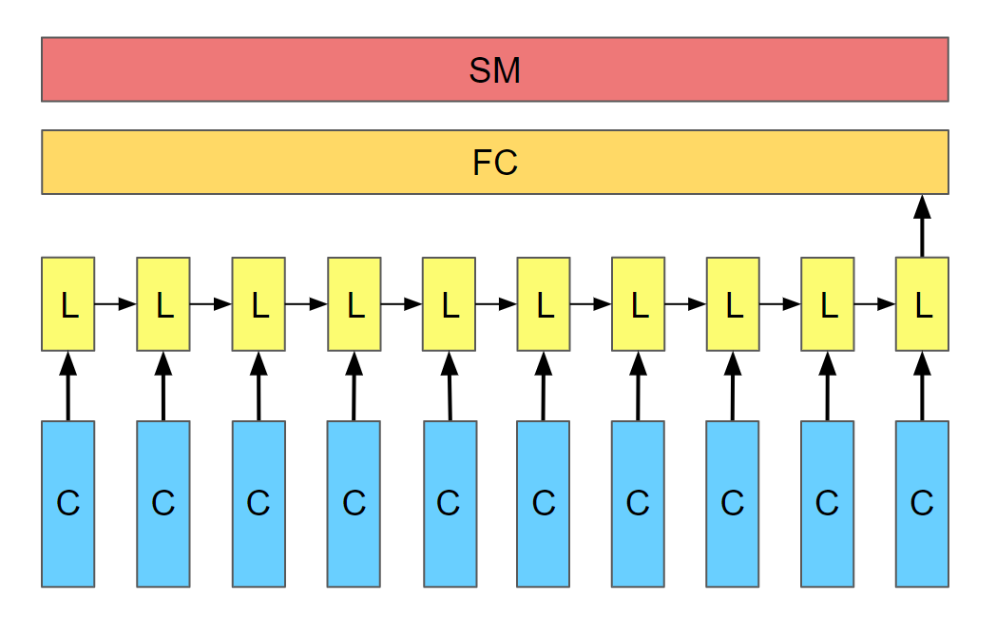
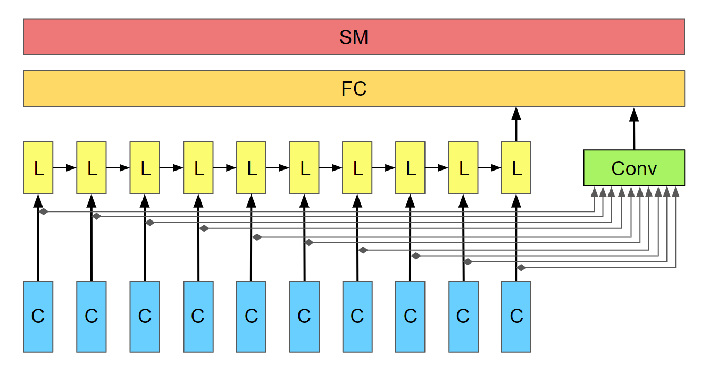
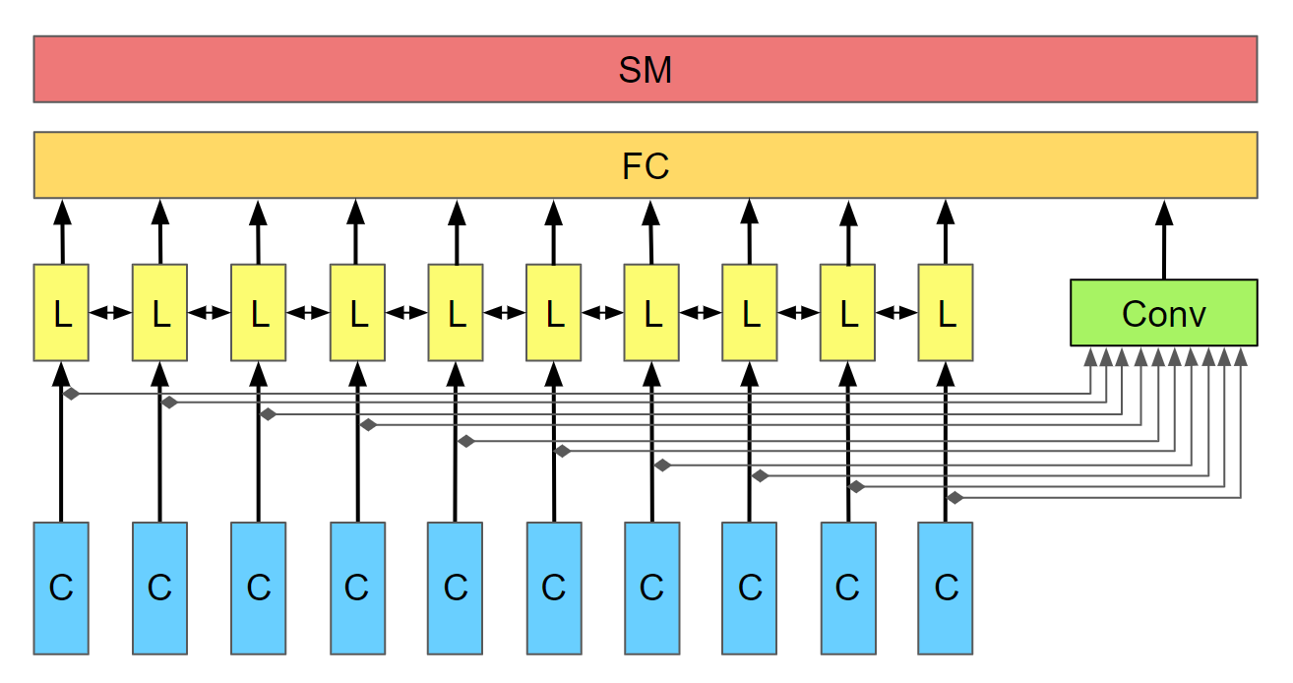
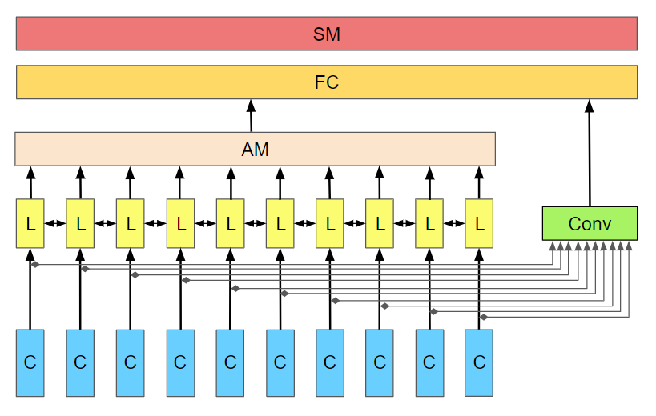
A) LSTM
B) Mixed LSTM / 1D Conv
C) Mixed BiLSTM / 1D Conv
D) Mixed Att-BiLSTM / 1D Conv

Slide 44
SM
FC
AM
L
L
L
L
L
L
L
L
L
L
Conv
C
C
C
C
C
C
C
C
C
C

Slide 45
SM
FC
L
L
L
L
L
L
L
L
L
L
Conv
C
C
C
C
C
C
C
C
C
C

Slide 46
SM
FC
AM
L
L
L
L
L
L
L
L
L
L
L
L
L
L
L
L
L
L
L
L
Conv
C
C
C
C
C
C
C
C
C
C

Slide 47
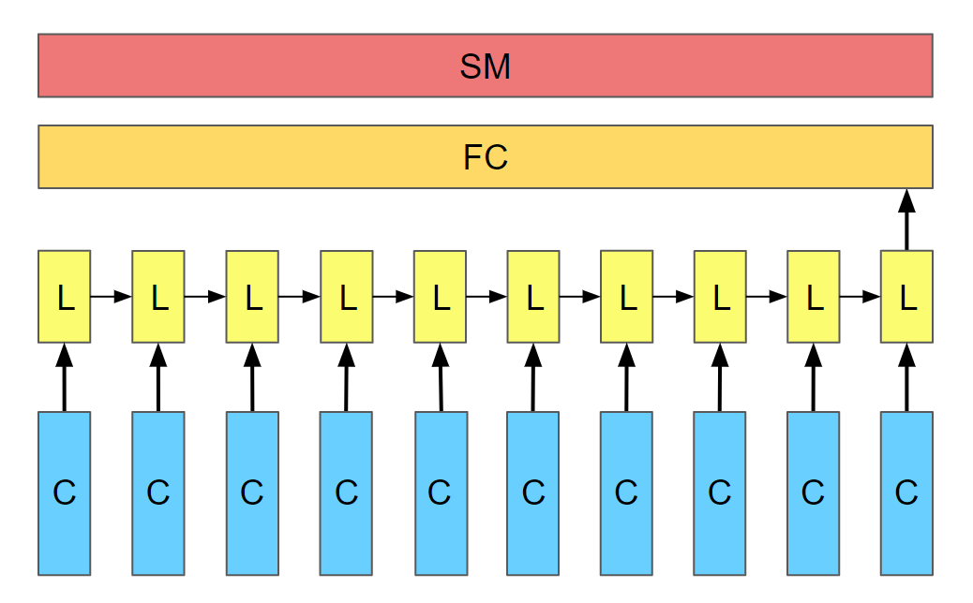
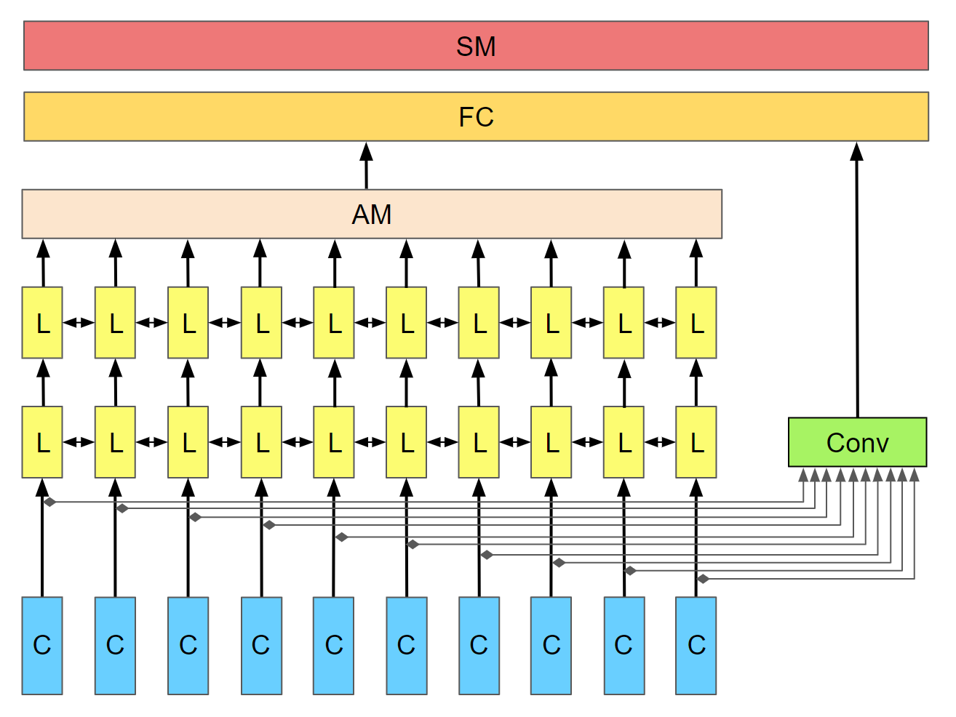

Slide 48
SM
FC
L
L
L
L
L
L
L
L
L
L
Conv
C
C
C
C
C
C
C
C
C
C

Slide 49
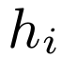
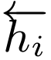
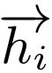
Attention layer
LSTM layer
CNN
layer
C
C
C
C
C
C
C
C
C
C

Slide 50
Attention layer
LSTM layer
CNN
layer
C
C
C
C
C
C
C
C
C
C

Slide 51
SM
FC
AM
L
L
L
L
L
L
L
Conv
C
C
C
C
C
C
C

Slide 52
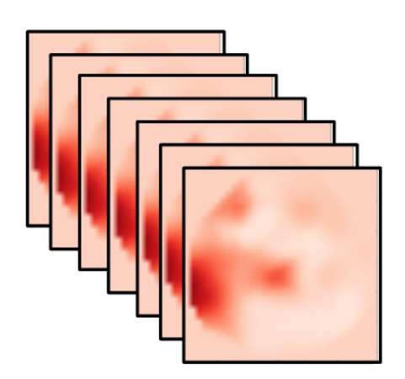
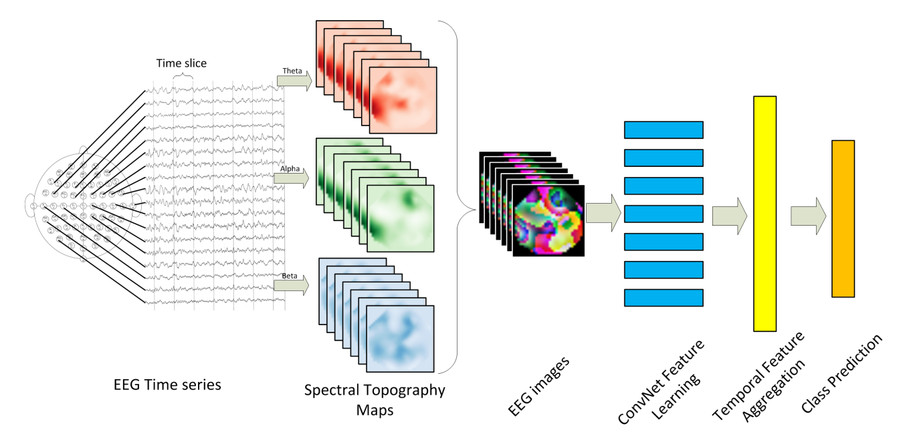
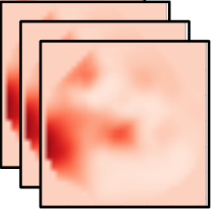
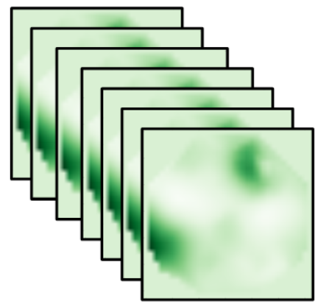
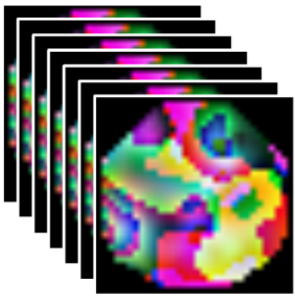




Time slice
Theta
No pain
Alpha
Conv
ICA
Conv
Conv
LSTM+AM
Conv
Conv
Alpha
Conv
Conv
Conv
Conv
Conv
Conv
Conv
Conv
Beta
Conv
Conv
Conv
Conv
EEG Time Series
Temporal Feature Aggregation
Pain Intensity Assessment
Pain Location Assessment
Spectral Topography Maps
EEG Images
Spatial Feature Learning
Notes:
Note:
These visuals can represent a multi-directional array (3D)
Author: Elvis Saravia (ellfae@gmail.com)

Slide 53
Conv
Conv
Conv
Conv
Conv
Conv
Conv
Conv
Conv
Conv

Slide 54



Slide 56






Activations
(U=WX)
Scalp maps
( )

Slide 57




Slide 58



Slide 59


Slide 60
Test Subject | S1 | S2 | S3 | S4 | S5 | S6 | S7 | S8 | S9 | S10 | S11 | S12 | S13 | Average Accuracy
Pain Intensity | 0.8209 | 0.8882 | 0.9569 | 0.9625 | 0.9322 | 0.9563 | 1 | 0.9707 | 0.9809 | 0.9226 | 0.9015 | 0.892 | 0.8094 | 0.922623077
Pain Location | 0.7243 | 0.8028 | 0.9397 | 0.9951 | 0.9286 | 1 | 0.9948 | 0.9088 | 0.8844 | 0.8956 | 0.8816 | 0.7081 | 0.7591 | 0.878684615

Slide 61


Slide 62



Slide 63

C
C
C
CNN
Layer

Slide 65



Slide 66


Slide 67





Slide 68
Input
Conv3-32
x4
Maxpool
Conv3-64
x2
32x32x3
Maxpool
(2x2)
Conv3-128
x1
Maxpool
(2x2)
Output
FC-512
Feature
Vector
Notes:
Note:
These visuals can represent a multi-directional array (3D)
Author: Elvis Saravia (ellfae@gmail.com)

Slide 69
Architectures
Notes:
Note:
You can add abstract backgrounds here

Slide 70
Hidden Layers
Input Layer
a^{[1]}₁
a^{[2]}₁
a^{[3]}₁
Output Layer
a^{[1]}₂
a^{[2]}₂
a^{[3]}₂
a^{[4]}
Ŷ
X
a^{[1]}₃
a^{[2]}₃
a^{[3]}₃
a^{[1]}_{n}
a^{[2]}_{n}
a^{[3]}_{n}
X = A^{[0]}
A^{[1]}
A^{[2]}
A^{[3]}
A^{[4]}
Notes:
Created By @srvmshr
sourav@yahoo.com

Slide 71
Hidden Layers
Input Layer
^{[1}a]₁
a^{[2]}₁
a^{[3]}₁
Output Layer
a^{[1]}₂
a^{[2]}₂
a^{[3]}₂
a^{[4]}
Ŷ
X
a^{[1]}₃
a^{[2]}₃
a^{[3]}₃
a^{[1]}_{n}
a^{[2]}_{n}
a^{[3]}_{n}
X = A^{[0]}
A^{[1]}
A^{[2]}
A^{[3]}
A^{[4]}
Notes:
Created By @srvmshr
sourav@yahoo.com

Slide 72
Hidden Layers
Input Layer
a^{[1]}₁
a^{[2]}₁
a^{[3]}₁
Output Layer
a^{[1]}₂
a^{[2]}₂
a^{[3]}₂
a^{[4]}
Ŷ
X
a^{[1]}₃
a^{[2]}₃
a^{[3]}₃
a^{[1]}_{n}
a^{[2]}_{n}
a^{[3]}_{n}
X = A^{[0]}
A^{[4]}
A^{[1]}
A^{[2]}
A^{[3]}
Notes:
Original by @srvmshr
sourav@yahoo.com
Dark themed version by (Elvis Saravia - ellfae@gmail.com)

Slide 73
All models are wrong, but some are useful.
Notes:
Original by @srvmshr
sourav@yahoo.com
Dark themed version by (Elvis Saravia - ellfae@gmail.com)

Slide 74
CONV operation
MxM
ReLU
+b1
+b1
MxMX2
+b2
+b2
NxNx3
MxM
ReLU
a^{[l-1]}
a^{[l]}
Notes:
Added by @srvmshr
Sourav @ yahoo.com

Slide 75
CONV operation
MxM
ReLU
+b1
+b1
MxMX2
+b2
+b2
NxNx3
MxM
ReLU
Notes:
Added by @srvmshr
Sourav @ yahoo.com

Slide 76
CONV operation
MxM
ReLU
+b1
+b1
MxMX2
+b2
+b2
NxNx3
MxM
ReLU
Notes:
Added by @srvmshr
Sourav @ yahoo.com

Slide 77
Striding in CONV
S=1
S=2
Notes:
Created by @srvmshr
Sourav @ yahoo.com

Slide 78
Inception Module
MaxPool Same s=1
5x5 Same
3x3 Same
NxNx192
1x1 Same
NxNx192
NxNx128
NxNx32
NxNx64
Notes:
Created by @srvmshr
Sourav @ yahoo.com

Slide 79

Notes:
Note:
This diagram could represent a simple logistic regression model; you can generalize to deep neural network by adding layers (see next slide)
Author: Elvis Saravia (ellfae@gmail.com)

Slide 80
Notes:
Note:
1 hidden layer neural network
Author: Elvis Saravia (ellfae@gmail.com)

Slide 81
Softmax
Linear
Add & Norm
Feed
Forward
Add & Norm
Add & Norm
Multi-Head
Attention
Feed
Forward
Add & Norm
Add & Norm
Masked
Multi-Head
Attention
Multi-Head
Attention
Positional
Encoding
Positional
Encoding
Input
Embedding
Output
Embedding
Inputs
Outputs (shifted right)
Notes:
Note:
Using the same visual components from before and a few new custom ones, I was able to come up with the Transformer architecture
This is a reproduction of the Transformer architecture figure presented in the work of Vaswani et al. 2017
You can further customize it however you want
Author: Elvis Saravia (ellfae@gmail.com)

Slide 82
Softmax
Linear
Add & Norm
Feed
Forward
Add & Norm
Add & Norm
Multi-Head
Attention
Feed
Forward
Add & Norm
Add & Norm
Masked
Multi-Head
Attention
Multi-Head
Attention
Positional
Encoding
Positional
Encoding
Input
Embedding
Output
Embedding
Inputs
Outputs (shifted right)
Notes:
Note:
Using the same visual components from before and a few new custom ones, I was able to come up with the Transformer architecture
This is a reproduction of the Transformer architecture figure presented in the work of Vaswani et al. 2017
You can further customize it however you want
Author: Elvis Saravia (ellfae@gmail.com)

Slide 83
I
love
coding
and
writing
Tokenize
“I love coding and writing”
Notes:
Note:
This figure aims to demonstrate the process of tokenization
If you want to change the gradient colors of this shape, you can simply click on the shape and then select “Fill color” (the bucket looking icon at the top).
This is a gradient color so you can customize however you want
Author: Elvis Saravia (ellfae@gmail.com)

Slide 84
ML Concepts
Notes:
Note:
Gradient background shows some inspirations and ideas for color themes that could be used for backgrounds
The examples used in this section are inspired by https://uigradients.com

Slide 85
Size
Family?
X
Y
#bed
Walk?
PRICE ŷ
Basic Neuron Model
ZIP
School
How does NN work (Insprired from Coursera)
Wealth
Ŷ = 0
X
Logistic Regression
Ŷ = 1
Notes:
By @srvmshr
sourav@yahoo.com

Slide 86
Linear regression
ReLU(x)
$
$
Size
Size
Notes:
By @srvmshr
sourav@yahoo.com

Slide 87
256
225
56
.
.
.
214
210
211
NxN
NxN
NxN
NxN
R-G-B
Unrolling Feature vectors
Notes:
By @srvmshr
sourav@yahoo.com

Slide 88
Large NN
Med NN
η
Small NN
SVM,LR etc
Amount of Data
Why does Deep learning work?
Notes:
By @srvmshr
sourav@yahoo.com

Slide 89
Hidden
Input
Output
a^{[1]}₁
a^{[1]}₂
One hidden layer neural network
X
a^{[2]}
Ŷ
a^{[1]}₃
a^{[1]}₄
X = A^{[0]}
A^{[1]}
A^{[2]}
Notes:
By @srvmshr
sourav@yahoo.com

Slide 90
a^{[1]}₁
x_{[1]}
a^{[2]}
a^{[1]}₂
x_{[2]}
x_{[1]}
x_{[2]}
x_{[3]}
Neural network templates
Notes:
By @srvmshr
sourav@yahoo.com

Slide 91
Train
Valid
Test
Underfitting
Good fit
Overfitting
x2
x2
x2
x1
x1
x1
Train-Dev-Test vs. Model fitting
Notes:
By @srvmshr
sourav@yahoo.com

Slide 92
x_{[1]}
x_{[2]}
a_{[L]}
DropOut
x_{[3]}
x2
r=1
x2
Normalization
x1
x1
Notes:
By @srvmshr
sourav@yahoo.com

Slide 93
J
w2
Early stopping
Err
w1
w1
w2
Before Normalization
Dev
Train
it.
J
w2
w1
w1
After Normalization
w2
Notes:
By @srvmshr
sourav@yahoo.com

Slide 94
x₁
x₂
w[L]
w[1]
w[2]
w[L-2]
w[L-1]
Deep neural networks
FN
TN
TP
FP
Understanding
Precision & Recall
Notes:
By @srvmshr
sourav@yahoo.com

Slide 95


Batch vs. Mini-batch Gradient Descent
w2
w2
BGD
SGD
Batch Gradient Descent vs. SGD
SGD
w1
w1
Notes:
By @srvmshr
sourav@yahoo.com

Slide 96
x_{[1]}
p_{[1]}
x_{[2]}
p_{[2]}
x_{[3]}
Softmax Prediction with 2 outputs
Notes:
By @srvmshr
sourav@yahoo.com

Slide 97
Abstract backgrounds
Notes:
Note:
You can add abstract backgrounds here

Slide 98
Notes:
Note:
You can change the gradient of each component
Author: Elvis Saravia

Slide 99
dair.ai
Notes:
Note:
This is the header I use for the dair.ai NLP Newsletter
You can change the gradient of each component
You can customize the background as well by right clicking and changing to another gradient or static color
Author: Elvis Saravia

Slide 100
Notes:
Note:
This is the header I use for the dair.ai NLP Newsletter
You can change the gradient of each component
Author: Elvis Saravia

Slide 101
Notes:
Note:
This is the header I use for the dair.ai NLP Newsletter
You can change the gradient of each component
Author: Elvis Saravia

Slide 102
Gradient Backgrounds
Notes:
Note:
Gradient background shows some inspirations and ideas for color themes that could be used for backgrounds
The examples used in this section are inspired by https://uigradients.com

Slide 106
Other examples

Slide 107
3
16+32
16
16
16
16
1
Convolution 3x3
Convolution 1x1
Dropout 0.1
Max Pooling 2x2
Skip connection
Dropout 0.2
Up Sampling 2x2
Block copied
Dropout 0.3
32
32
32+64
32
64
64
64+128
64
128
128
128+256
128
256
256
Notes:
By @avsthiago

Slide 108
Input:
(None, size, size, 3)
InputLayer
Output:
(None, size, size, 3)
Inception-v3 architecture
Input:
(None, 14, 14, 2048)
GlobalAveragePooling2D
Output:
(None, 2048)
Input:
(None, 2048)
Dense
Activation
ReLU
Output:
(None, 1024)
Input:
(None, 1024)
Dense
Activation
Softmax
Output:
(None, 7)
Notes:
By @avsthiago

Slide 109
Layer1
Layer2
Layer3
Layer1
Layer2
Layer3
Layer4
Input
Output
Conv3-32
Conv3-32
Conv3-32
Conv3-32
Max-Pool
Conv3-64
Max-Pool
Conv3-128
Max-Pool
Conv3-64
FC-512
Input
Conv
Max-Pool
Conv
Max-Pool
FC
FC
Softmax
Layer1
Layer2
Layer3
Layer4
Conv3-32
Output
Feature
Vector
Conv3-32
Conv3-32
Conv3-32
Max-Pool
Conv3-64
Max-Pool
Conv3-128
Max-Pool
Conv3-64
FC-512
Notes:
By @avsthiago

Slide 110
Filter concatenation
3x3 convolutions
5x5 convolutions
1x1 convolutions
1x1 convolutions
1x1 convolutions
1x1 convolutions
3x3 max pooling
Previous layer
Notes:
By @avsthiago

Slide 111
Filter concatenation
3x3 convolutions
5x5 convolutions
1x1 convolutions
1x1 convolutions
1x1 convolutions
1x1 convolutions
3x3 max pooling
Previous layer
Notes:
By @avsthiago

Slide 112
Output
FC
FC
1x7 conv
1x7 conv
Inception 2
Inception 2
Inception 2
Inception 1
1x11 conv
1x11 conv
Input

Slide 114
Previous layer
1x3 conv,
1 padding
1x3 conv,
1 padding
1x7 conv,
3 padding
1x3 conv,
1 padding
1x5 conv,
2 padding
1x3 conv,
1 padding
Filter concatenation

Slide 115
Avg-Pool
Auxiliary Classifier
Conv
FC
FC
Softmax
Inception
Input
Inception
Conv
Max-Pool
Conv
Max-Pool
Conv
Max-Pool
Inception
Inception
Max-Pool
Inception
Inception
Inception
Inception
Inception
Max-Pool
Avg-Pool
Conv
FC
Softmax
Avg-Pool
Auxiliary Classifier
Conv
FC
FC
Softmax
Notes:
By @avsthiago

Slide 116
Filter concatenation
Filter concatenation
3x3 conv.
1x3 conv.
3x1 conv.
1x1 conv.
3x3 conv.
3x3 conv.
1x1 conv.
1x3 conv.
3x1 conv.
3x3 conv.
1x1 conv.
1x1 conv.
Pool
1x1 conv.
1x1 conv.
Pool
1x1 conv.
1x1 conv.
Previous layer
Previous layer
(a)
(b)
Notes:
By @avsthiago

Slide 117
Previous input
Previous input
x
x
F(x)
F(x)
Stacked layers
Stacked layers
x
identity
+
y=F(x)
y=F(x)+x
R1
R1
R2
R1
R1
R2
R3
R1
R2
R3
Notes:
By @avsthiago

Slide 118
Dense Block 1
Dense Block 2
Dense Block 3
Softmax
FC
Avg-Pool
Avg-Pool
Conv
Conv
Input
Avg-Pool
Conv
Transition layers
Notes:
By @avsthiago

Slide 119

h_{i+1}
Filter concatenation
h_{i+1}
add
add
Filter concatenation
3x3 max
3x3 conv
3x3 avg
identity
add
add
add
add
add
add
add
add
3x3 conv
identity
3x3 conv
5x5 conv
3x3 avg
identity
3x3 avg
3x3 avg
3x3 conv
5x5 conv
7x7 conv
5x5 conv
3x3 max
7x7 conv
3x3 avg
5x5 conv
h_{i}
h_{i}
...
...
h_{i-1}
h_{i-1}
(a)
(b)
Notes:
By @avsthiago

Slide 120
Notes:
By @avsthiago

Slide 121
Notes:
By @avsthiago
Dark-theme version of the previous (by Elvis Saravia)

Slide 122
Max(1,1,5,6) = 6
Y
1
1
2
4
5
6
7
8
6
8
3
2
1
0
Pooling performed with a 2x2 kernel and a stride of 2
3
4
1
2
3
4
X
Image Representation
Notes:
By @avsthiago

Slide 123
Advantages | Disadvantages
only one process enters the critical section at a time, and the system can achieve mutual exclusion | the algorithm has low fault-tolerance
tokens are passed in a fair circle, and any node will get the chance to enter the critical zone without starvation | token loss detection is more difficult
the number of messages sent by the token once in the system is at most N-1 | in the physical ring, when a token joins or exits, the network structure needs to be reconfigured, which is more complicated
the algorithm is simple in principle and easy to implement | during the reconfiguration process, no node in the system can access the critical section, which is expensive

